Slide 1
Snowflake

Slide 2
Intro
Snowflake is a fully managed, cloud-native data platform designed to unify data storage, processing, analytics, and AI workloads in a single, scalable environment.
it operates as a SaaS (Software as a Service) solution across major cloud providers—AWS, Azure, and Google Cloud—eliminating the need for users to manage hardware, software installations, or infrastructure maintenance.
Snowflake combines a SQL-based query engine with cloud-native architecture, supporting a wide range of use cases including data warehousing, data lakes, data engineering, data science, machine learning (ML), application development, and secure real-time data sharing.
As of 2025, enhancements like Unistore (combining OLTP and OLAP) and hybrid tables further extend its capabilities to transactional processing alongside analytics.

Slide 3
Key features
Elastic Scalability: Independently scale storage and compute resources on demand, paying only for what you use, which optimizes costs and handles variable workloads efficiently.
Concurrency and Performance: Supports unlimited concurrent users and queries without resource contention, leveraging multi-cluster isolation for consistent speed.
Data Sharing and Collaboration: Enables secure, zero-copy data sharing across organizations via the Snowflake Marketplace, Data Clean Rooms, and reader accounts—no data movement required.
AI and ML Integration: Simplifies feature engineering, model training, and inference directly on Snowflake data, avoiding costly data exports to external platforms.

Slide 4

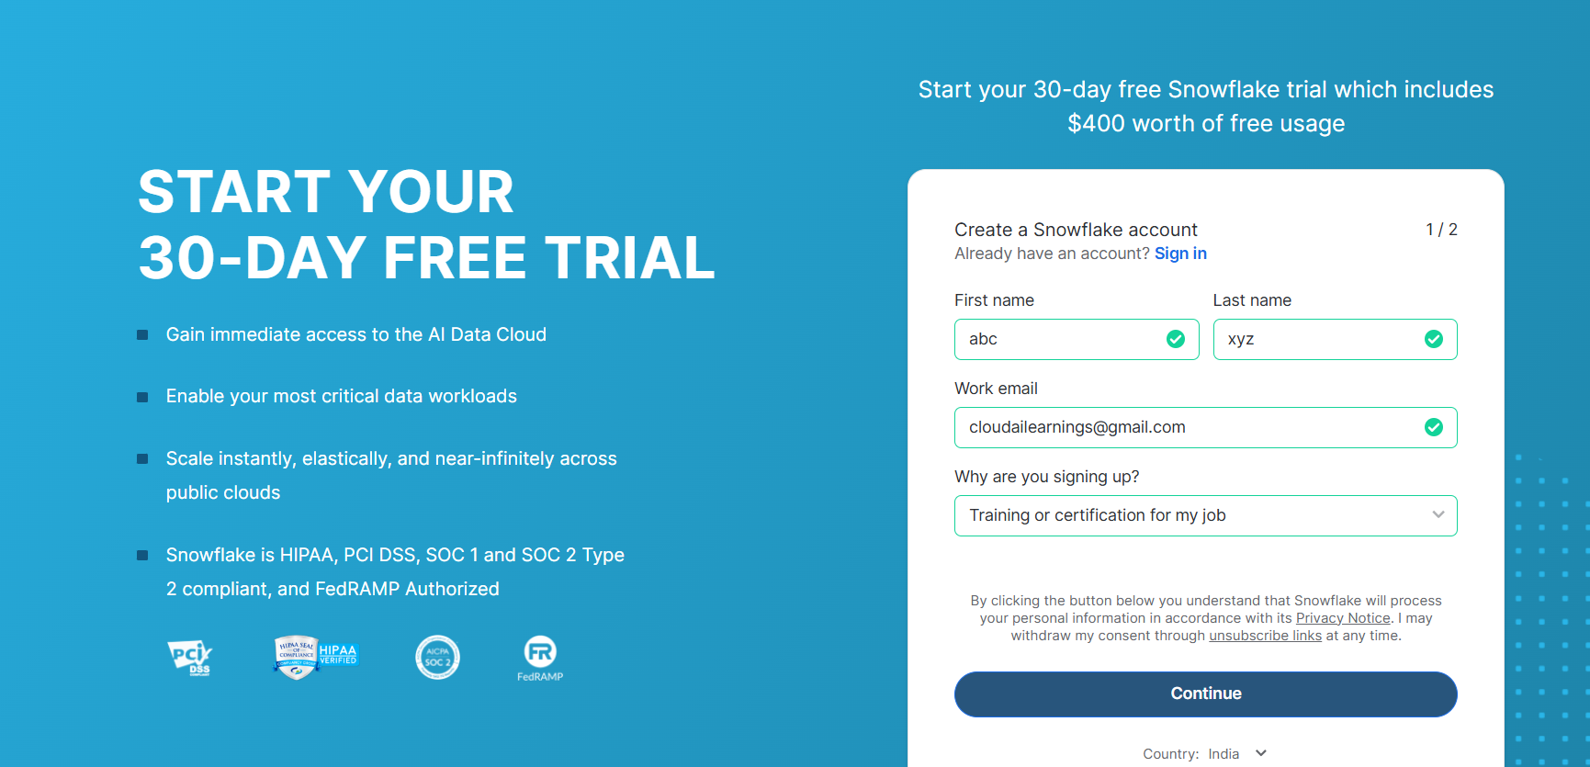
Snowflake Setup

Slide 5
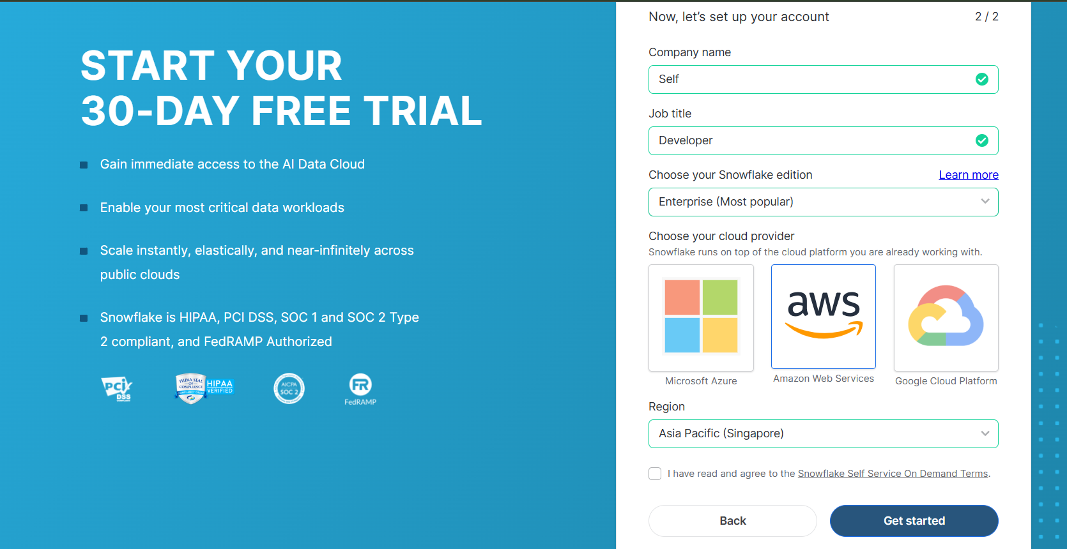

Slide 6
Snowflake Architecture
Snowflake's architecture is uniquely designed for the cloud, blending the simplicity of shared-disk systems (centralized storage) with the scalability of shared-nothing models (distributed compute).
The platform consists of three decoupled layers—Storage, Compute, and Cloud Services—that integrate logically while operating independently for flexibility.

Slide 7
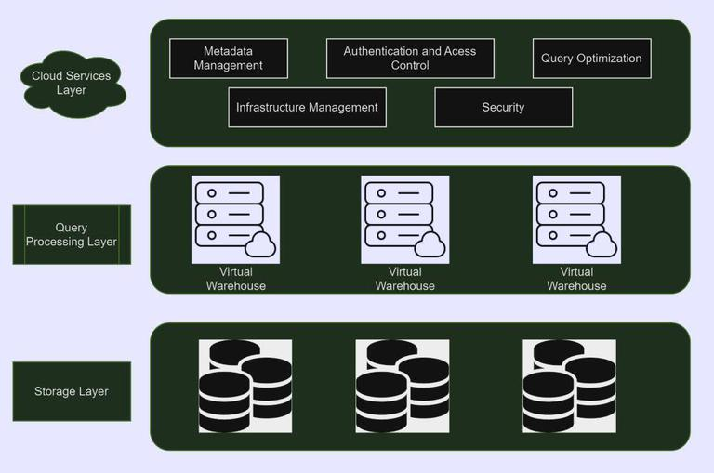

Slide 8
Layer | Description | Key Components and Features
Storage | Central, persistent repository for all data, accessible by all compute nodes. Data is automatically optimized, compressed, and stored in a columnar format divided into immutable micro-partitions (typically 50-500 MB each) for efficient querying and pruning. | - Supports unlimited data size. - Table types: Snowflake tables (for warehousing), Apache Iceberg tables (for data lakes/lakehouses with external storage like S3), Hybrid tables (for low-latency OLTP with row locking, indexes, and constraints). - Handles structured, semi-structured, and unstructured data. - Features: Automatic clustering, metadata statistics for query optimization.
Compute | Independent virtual warehouses (clusters of compute resources) that execute SQL queries, Snowpark code (e.g., Python, Java), or Spark jobs via Snowpark Connect. No resource sharing between warehouses ensures workload isolation. | - Multi-cluster warehouses for dynamic scaling and concurrency. - Elastic: Resize or auto-scale in seconds; suspend when idle to save costs. - MPP processing: Each node handles a data subset locally for speed. - Caching: Result sets, metadata, and local disk caches for sub-second queries.
Cloud Services | Metadata management and orchestration layer that handles non-data-processing tasks, running on separate cloud-provisioned instances. | - Authentication, authorization, and security (e.g., role-based access, encryption). - Query parsing, optimization, and coordination. - Logging, billing, and infrastructure management. - Integrates with data sharing (e.g., secure views, Marketplace listings).

Slide 9
Storage layer
Snowflake's storage layer is elastic, allowing organizations to scale their storage needs independent of compute resources.
It ensures to handle various data volumes without affecting performance.
Snowflake uses cloud based object storage to store data. This separation of storage and compute allows for cost-effective and scalable data storage.
Snowflake organizes data into micro partitions within the object storage, and these micro partitions are clustered based on metadata. This clustering enhances query performance by minimizing the amount of data that needs to be scanned.
Snowflake enables efficient data cloning through zero-copy cloning technology.

Slide 10
Query Processing Layer
The SQL query execution is handled by Snowflake's Query Processing Layer, which dynamically optimizes and parallelizes queries over several compute clusters.
Automatic Query Processing:
Parallel Execution across Clusters:
On Demand Resource Allocation
Compute and Storage Separation

Slide 11
Cloud Services Layer
In Snowflake's architecture, the Cloud Services Layer serves as the control plane, managing information, security, and user access.
It serves as a centralized platform for administration, authentication, and activity coordination across the data warehouse.
Metadata Management
Authentication and Access Control
Query Optimization
Infrastructure Management
Security

Slide 12
Cloud Services Layer
In Snowflake's architecture, the Cloud Services Layer serves as the control plane, managing information, security, and user access.
It serves as a centralized platform for administration, authentication, and activity coordination across the data warehouse.
Metadata Management
Authentication and Access Control
Query Optimization
Infrastructure Management
Security

Slide 13
Virtual Warehouses

Slide 14
What is a Snowflake Virtual Warehouse?
A Virtual Warehouse is a cluster of compute resources in Snowflake.
A warehouse provides the required resources, such as CPU, memory, and temporary storage, to perform various operations in Snowflake like executing SQL statements, performing data loading and unloading operations.

Slide 15
Steps to create a Snowflake Virtual Warehouse
can create a Snowflake virtual warehouse through the web interface or using SQL.
Navigate to Warehouses and click Create.
Enter a Name and select the Size of the Warehouse.
Select the number of Minimum and Maximum clusters to create a Multi-cluster warehouse. Default values are 1 and 2 respectively.
Select the Scaling policy. Default is Standard.
Select the number of idle minutes after which the warehouse should automatically suspend using Auto Suspend. Default is 10 minutes.
The Auto Resume feature by default checked-in. Unselect if you don’t want the warehouse to resume automatically when a query is submitted.
Optionally fill in the comments section and click Finish.

Slide 16
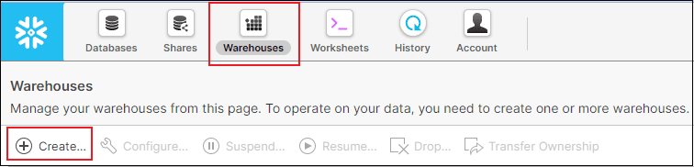
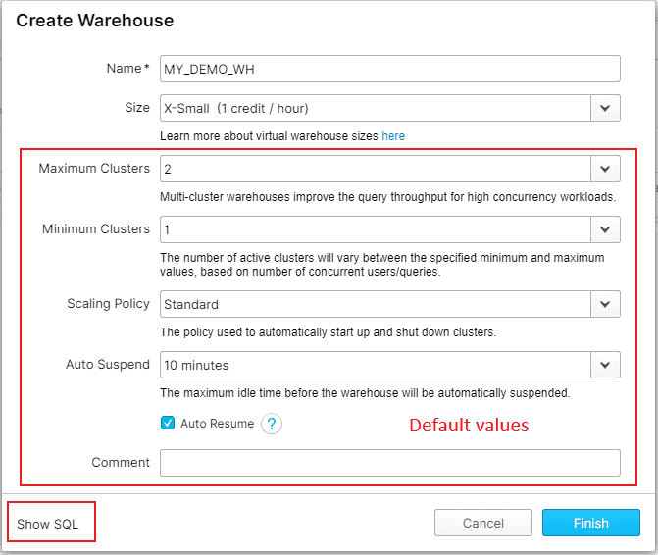

Slide 17
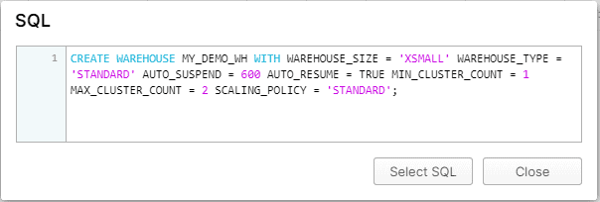
Click on Show SQL option to view the SQL statement to create the virtual warehouse

Slide 18
Virtual Warehouse Size and Credit Usage/Billing
Snowflake utilizes per-second billing( charges for first 60 seconds minimum each time the warehouse starts) so warehouses are billed only for the credits they actually consume.
Warehouse Size | X-Small | Small | Medium | Large | X-Large | 2X-Large | 3X-Large | 4X-Large | 5X-Large | 6X-Large
Credits/Hour | 1 | 2 | 4 | 8 | 16 | 32 | 64 | 128 | 256 | 512
Credits / Second | 0.0003 | 0.0006 | 0.0011 | 0.0022 | 0.0044 | 0.0089 | 0.0178 | 0.0356 | 0.0711 | 0.1422

Slide 19
Multi-cluster Warehouses
Multi-cluster warehouses enable you to automatically scale out compute resources to manage your concurrent users/queries needs as they change, such as during peak and off hours.
Multi-cluster warehouses are an Enterprise Edition feature.
Note that Multi-cluster warehouses are not as beneficial for improving the performance of slow-running queries or data loading. For these types of operations, Scaling up by resizing a warehouse provides more benefits.
Note that warehouse resizing is not intended for handling concurrency issues. Instead use Multi-cluster Warehouse where you could spin-up additional warehouses to handle the workload.

Slide 20
Warehouse sizing modes
Maximized Auto-Scale Modes
This mode is enabled by specifying the same value for both maximum and minimum number of clusters (note that the specified value must be larger than 1). In this mode, when the warehouse is started, Snowflake starts all the clusters so that maximum resources are available while the warehouse is running.
Auto-Scale Modes
This mode is enabled by specifying different values for maximum and minimum number of clusters. In this mode, Snowflake starts and stops clusters as needed to dynamically manage the load on the warehouse:
As the number of concurrent user sessions/queries for the warehouse increases, the queries start to queue due to insufficient resources. Snowflake then automatically starts additional clusters, up to the maximum number defined for the warehouse.
Similarly, as the load on the warehouse decreases, Snowflake automatically shuts down clusters to reduce the number of running clusters and, correspondingly, the number of credits used by the wareho

Slide 21
Scaling Policy
Snowflake supports the following scaling policies.
Standard:
It prevents/minimizes queuing by favoring starting additional clusters over conserving credits.
After the first cluster has begun, the following clusters wait 20 seconds before beginning.
Economy:
It conserves credits by favoring keeping running clusters fully-loaded rather than starting additional clusters.
A new cluster is started only if the system estimates there’s enough query load to keep the cluster busy for at least 6 minutes.

Slide 22
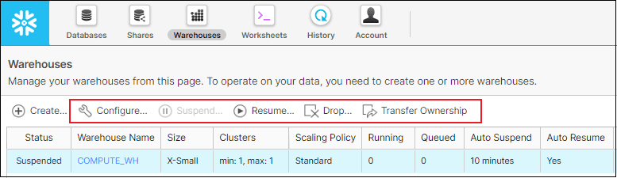
Auto Suspend and Auto Resume Warehouses
A warehouse can be set to automatically Suspend or Resume, based on activity
Auto Suspend
Auto Suspend is enabled by default while provisioning a warehouse.
Snowflake automatically suspends the warehouse if it is inactive for the specified period of time.
Auto Suspend ensures that you do not leave a warehouse running (and consuming credits) when there are no incoming queries.
Auto Resume
Auto Resume is enabled by default while provisioning a warehouse.
Snowflake automatically resumes the warehouse when any statement that requires a warehouse is submitted and the warehouse is the current warehouse for the session.
Auto Resume ensures that the warehouse starts up again as soon as it is needed.
alter warehouse my_wh resume; alter warehouse my_wh suspend; // manual

Slide 23
Finally
Separation of storage and compute allows users to scale each independently—e.g., add more compute for peak analytics without resizing storage—reducing complexity in data pipelines.
The architecture is multi-tenant yet isolated, with data distributed across cloud availability zones for high availability and fault tolerance

